Slide 1

Singapore Advanced Research and Education Network
www.singaren.net.sg
ipv6.singaren.net.sg
By
A/Prof. Bu-Sung Lee, francis

Slide 2
SingAREN: Background
Started in 1997 as a national project jointly funded by Telecom Authority of Singapore (TAS, now iDA) and National Science and Technology Board (NSTB, now A*STAR)
Mission
Advocate and champion advanced network applications and technology in Singapore.
Be the platform of collective representation of the community of research and education networks (REN) in Singapore.
Facilitate cost-competitive adoption of advanced Internet technologies for Singapore RENs.
Provide connectivity to advanced Research & Education Networks (RENs), such as Internet 2, TEIN, APAN, etc.
Re-constituted as not-for-profit self-help community society in 2003 with subscription-based business model.

Slide 3














SingAREN Members
Universities
Polytechnics
Government & Industries

Slide 4
Subscription Model
SingAREN Service Subscription Rates (with effect from 1 January 2012)
Annual membership fee of S$1,000
Bandwidth subscription fee
Old model (2003-Dec 2011)
User pay in terms of S$ per Mbps (S$1,100 per Mbps)
New Model(in effect from1Jan 2012)
Low (below 2 Mbps) - S$500 per month
Medium (2- 10 Mbps) - S$2,000 per month
High (10Mbps and above) – S$10,000 per month

Slide 5
Existing Facilities:
SingAREN Gigabit Internet Exchange (SingAREN-GIX)
Single point of presence – Iconic presence for Singapore
GE (Gigabit Ethernet) based network with max of 1 Gbits/s links
Multiple direct international routes
Resilient due to multiple paths to Asia, Oceania, Europe & USA
Open exchange and transit policy
IPv6 ready

Slide 6

SingAREN-GIX Connectivity (04 Jan 2012)
Google
Singapore
TEIN3
AARNet
GE Link
SOX
GE Link
GE Link
GE Link
PACNET
I1
SGIX
FE Link
FE Link
Rack
Rack
Rack
StarHub I1
FE Link
Microsoft
Singapore
GE Link
Vietnam/Mumbai/
HongKong /Europe
via TATA/
NRN
NICT
SingAREN
GLORIAD
NICT Japan
GE Link
GE Link
GE Link
NUS
GE Link
GE Link
GE Link
FE Link
GE Link
GE Link
FE Link
NTU
GE Link
SMA
NRF
BII
IHPC/
ACRC
HP Labs
RP
SP

Slide 7
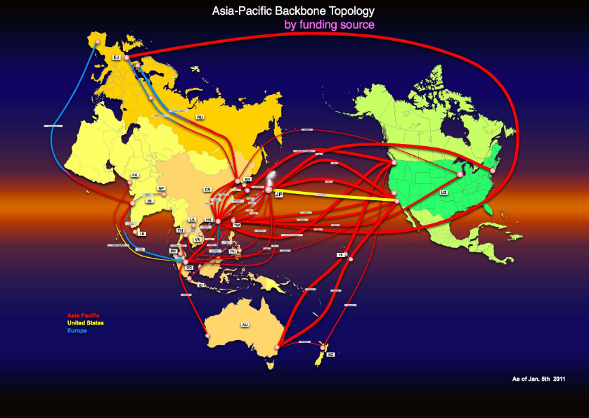
International Connections
NICT: 622Mbits/s ⇨ Providing connections to Asia,USA
AARNet: 622Mbits/s ⇨ Providing connections to AU
TEIN3: 90 Mbits/s ⇨ Providing connections to EU, AU, NZ, Asia
GLORIAD: 1Gbits/s ⇨ Providing connections to US, East Asia, IN*, EU*
* Under development

Slide 8
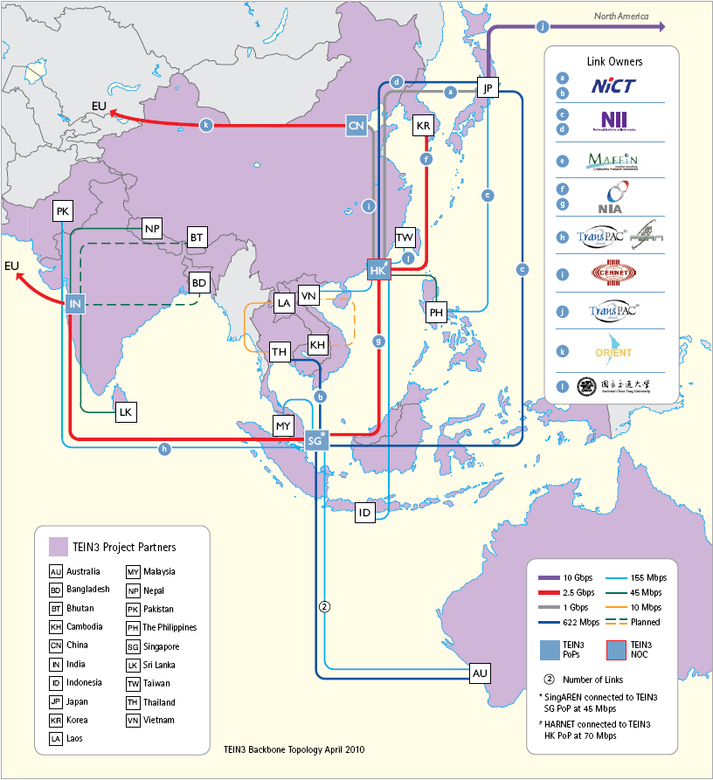
TEIN3-APAN network
- Connects 45+ million users from 8000+ research and academic centres to Europe and the rest of the world.
- 19 partners involved
- PoPs in China, India, Hong Kong, Singapore
- NOC in HK
Source: http://www.tein3.net/

Slide 9
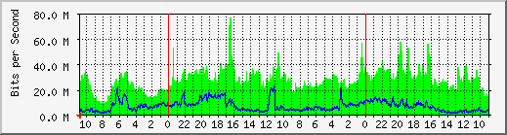
TEIN network traffic: Singapore prospective
1. RIKEN Advanced Science Institute
2. MRC Human Genome Mapping Project Resource Centre
3. University of Oxford
4. National Institute of Genetics
5. University of Lausanne
6. European Bioinformatics Institute
7. Queen Mary, University of London
8. Tsinghua University

Slide 10
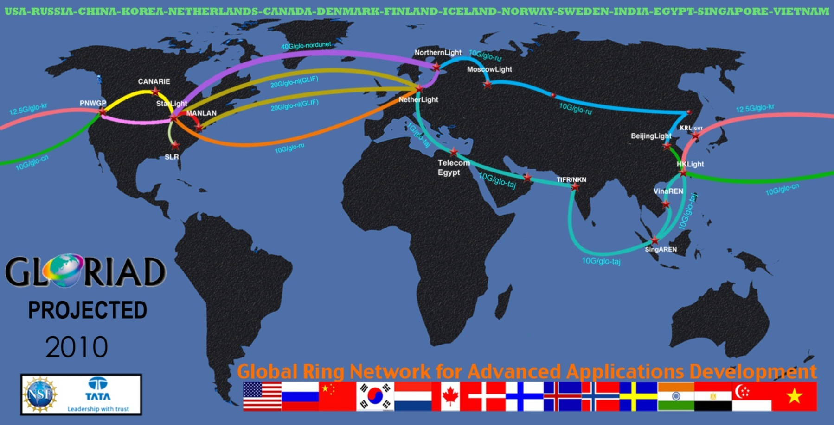
Gloriad-Taj Connection
1 Gbps link from Singapore to U.S. and *Europe
* in progress
Reference: http://www.gloriad.org

Slide 11
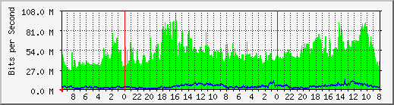
Gloriad Link traffic: Singapore perspective
Major users partner:
1. National Library of Medicine (Genome data)
2. Lawrence Livermore National Laboratory
3. Duke Medical school
4. University of Miami
5. National Centre for Atmospheric Research
6. University of Princeton

Slide 12
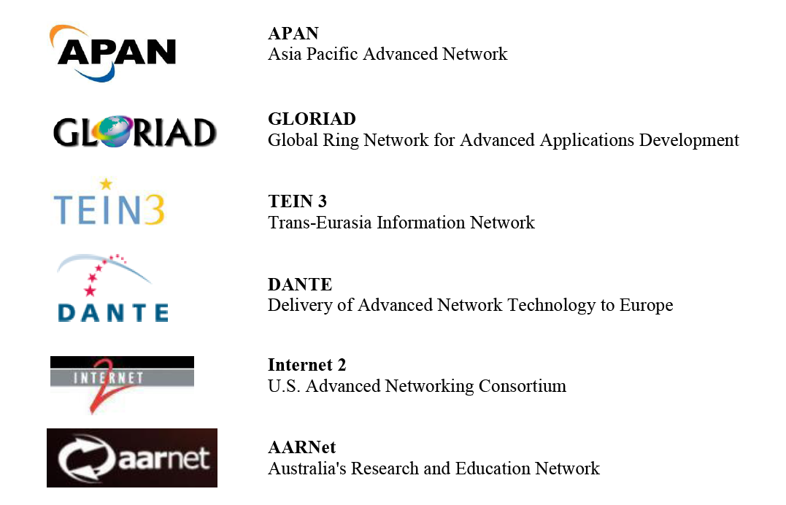
International Partners
Notes:
SingAREN fosters close relationships with our International Partners to facilitate peering arrangements.
This is an overview of our International Partners, including APAN (Asia Pacific Advanced Network), Internet2.

Slide 13
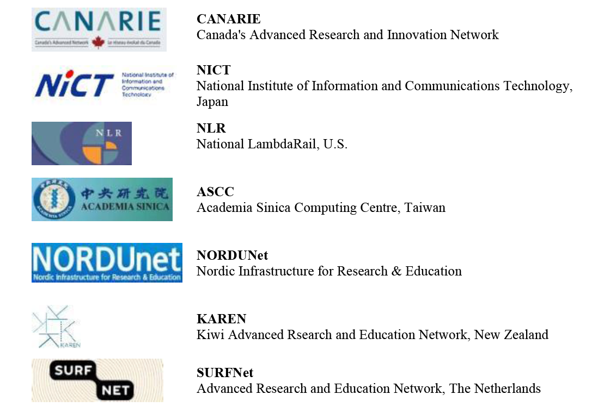
International Partners

Slide 14
New Member

Slide 15
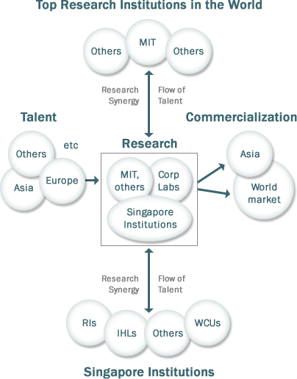
Campus for Research Excellence and Technological Enterprise(CREATE)

Slide 16
Centers in CREATE
Shanghai Jiao Tong University-NUS Research Centre on Energy and Environmental Sustainability Solutions for Megacities
Singapore-MIT Alliance for Research and Technology (SMART) Centre
The Singapore-ETH Center for Global Environmental Sustainability (SEC)
Technion-Israel Institute of Technology, NTU and NUS Centre for Regenerative Medicine
TUM-CREATE Centre on Electromobility in Megacities
Hebrew University of Jerusalem's Research Centre on Inflammatory Diseases
UC Berkeley's Berkeley Education Alliance for Research in Singapore (BEARS) Research Centre
Ben-Gurion University, Hebrew University of Jerusalem and NTU research centre for Energy and Water Management
Singapore-Peking University Research Centre for a Sustainable Low Carbon Future

Slide 17
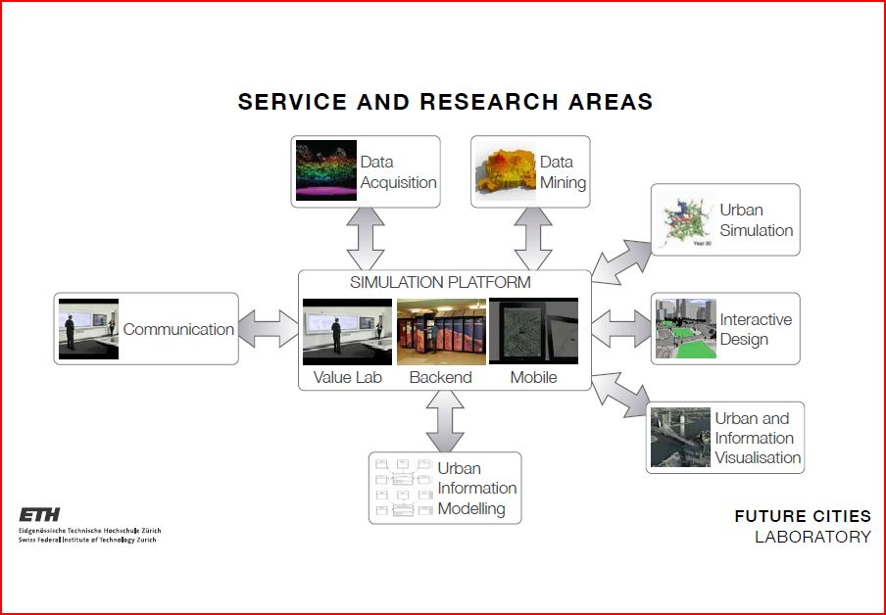
ETH Future City Lab

Slide 18
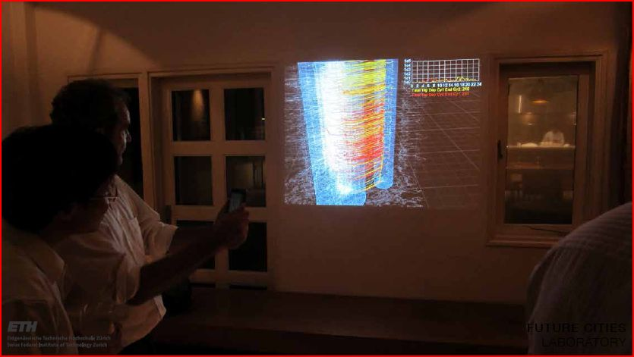
ETH – Visualisation project

Slide 19
IT support services - ETH
Microsoft Exchange access for all FCL researchers.
File Services(SFTP, CIFS) for document and research data exchange.
From small documents to 0.1 Tbytes(expected to grow)
Web services (Web Servers located in Switzerland)
Teleconference and Telepresence
NTU BeingThere Center, which involves Zurich.
Access to ETH Zurich and CSCS(Swiss National Supercomputer Center.) HPC resources.

Slide 20
The New Network: SLIX

Slide 21
Proposed Facilities: SingAREN-Lightwave Internet Exchange (SLIX)
SMU
SUTD
RP
SP
NP
NYP
TP
SIM
HP Labs
Google
SOX
SLIX
Microsoft
NICT
SGIX
NUS/CREATE
A*STAR
GLORIAD
NTU
ANC
TEIN
AARNet
Starhub
SLIX Core
SLIX Core forms backbone
Member/partner connections via FE, 1GE or 10GE

Slide 22
What Have We Enabled?

Slide 23

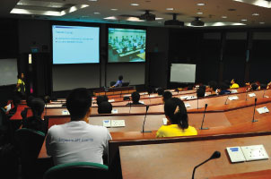
Distance Learning
Singapore-MIT Alliance (SMA) is an Engineering and Life Science educational and research collaboration by NUS, NTU and MIT.
SMA utilizes SingAREN’s R&E network to ensure seamless delivery of Distance Education Learning
Notes:
SMA utilized SingAREN’s R&E network for its distance education learning programmes.

Slide 24
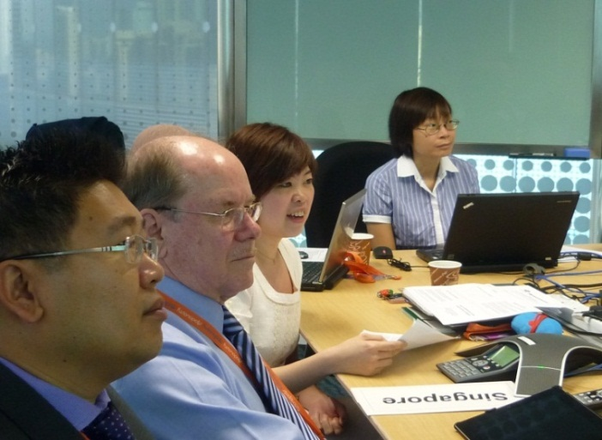
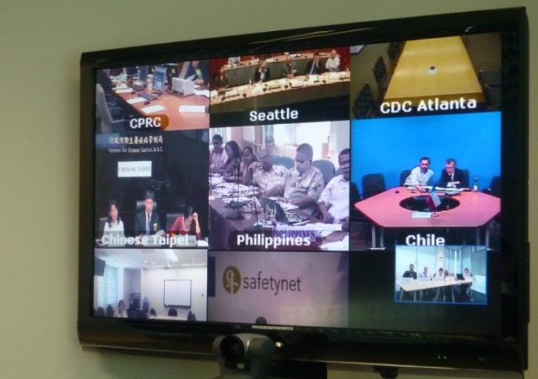
APEC-EINET Virtual Symposium 11 Nov 2011
APEC-EINET facilitates research and collaboration efforts of emerging infectious diseases in the Asia Pacific region.
SingAREN supported Ministry of Health and REDI Center’s participation in the APEC-EINET Virtual Symposium through provision of network infrastructure.

Slide 25

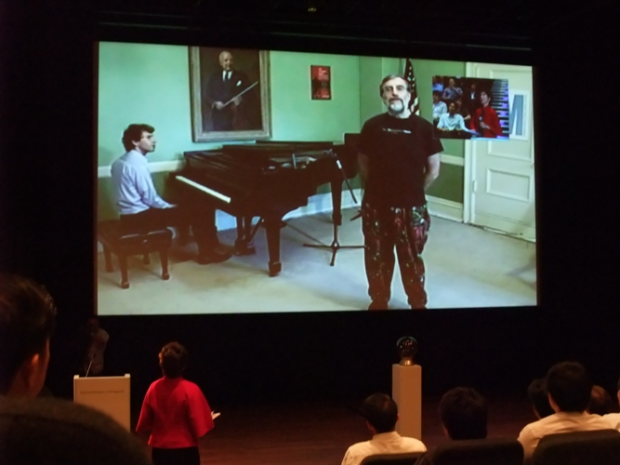
Digital Media Festival
Live interview between Singapore - New York, 4Mbps traffic via SingAREN

Slide 26
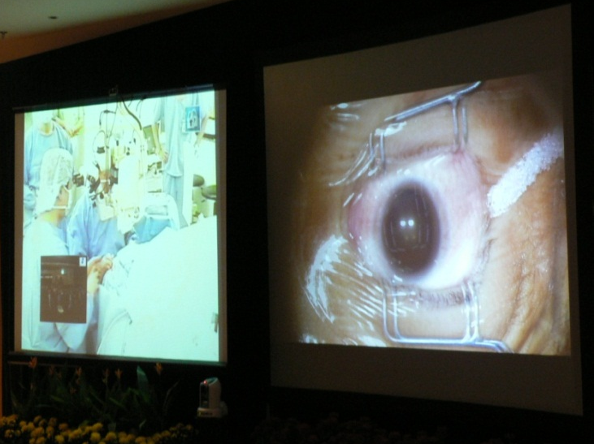
3D transmission of Eye Surgery 16 February 2006
SingAREN facilitated a 3D live transmission of an eye surgery performed in Asahikawa College, Japan. It was broadcasted at Singapore National Eye Centre.
3D HD technology opens up opportunities for surgical training and telemedicine.
Notes:
In Feb 2006, Singapore and Japan collaborated to transmit a cataract surgery in 3D High Definition images over real-time across the two countries.
The 3D HD technology enhances the teaching of surgery to doctors under training. It also facilitates more accurate diagnosis of a patient’s medical condition.

Slide 27
SingAREN Events

Slide 28
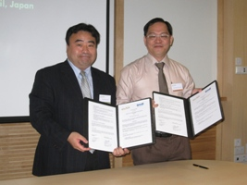
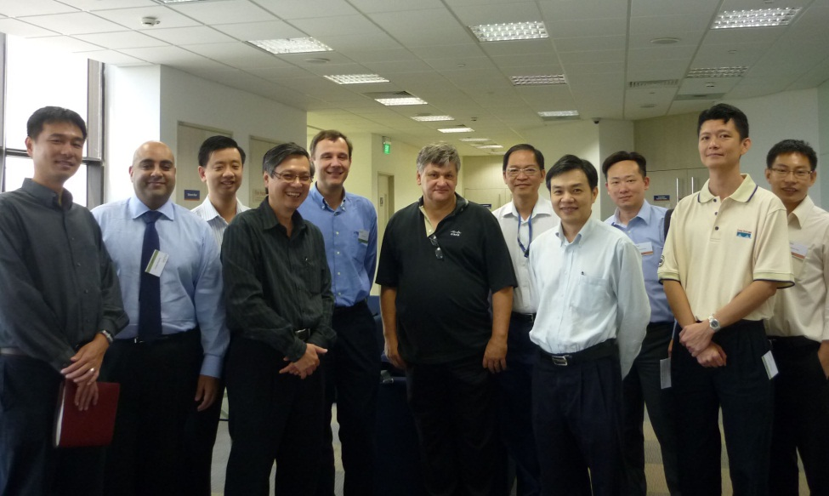
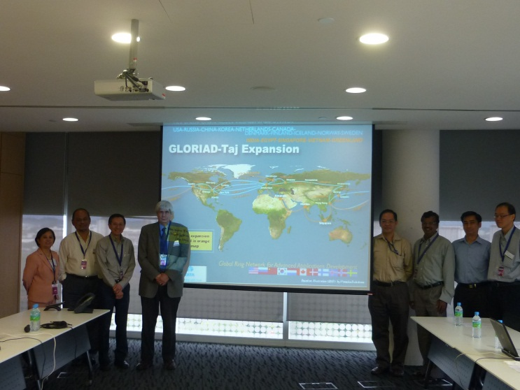
SingAREN Events
SingAREN Fest 2010 – signing of MOU between SingAREN and IPv6 Promotion Council, Japan
19 Nov 2010 – Seminar by Fred Baker, Cisco Fellow and Chair of IETF's IPv6 Operations Working Group
31 Jan 2011 – Seminar by Joe Mambretti, Director of the International Center for Advanced Research (iCAIR),Northwestern University

Slide 29
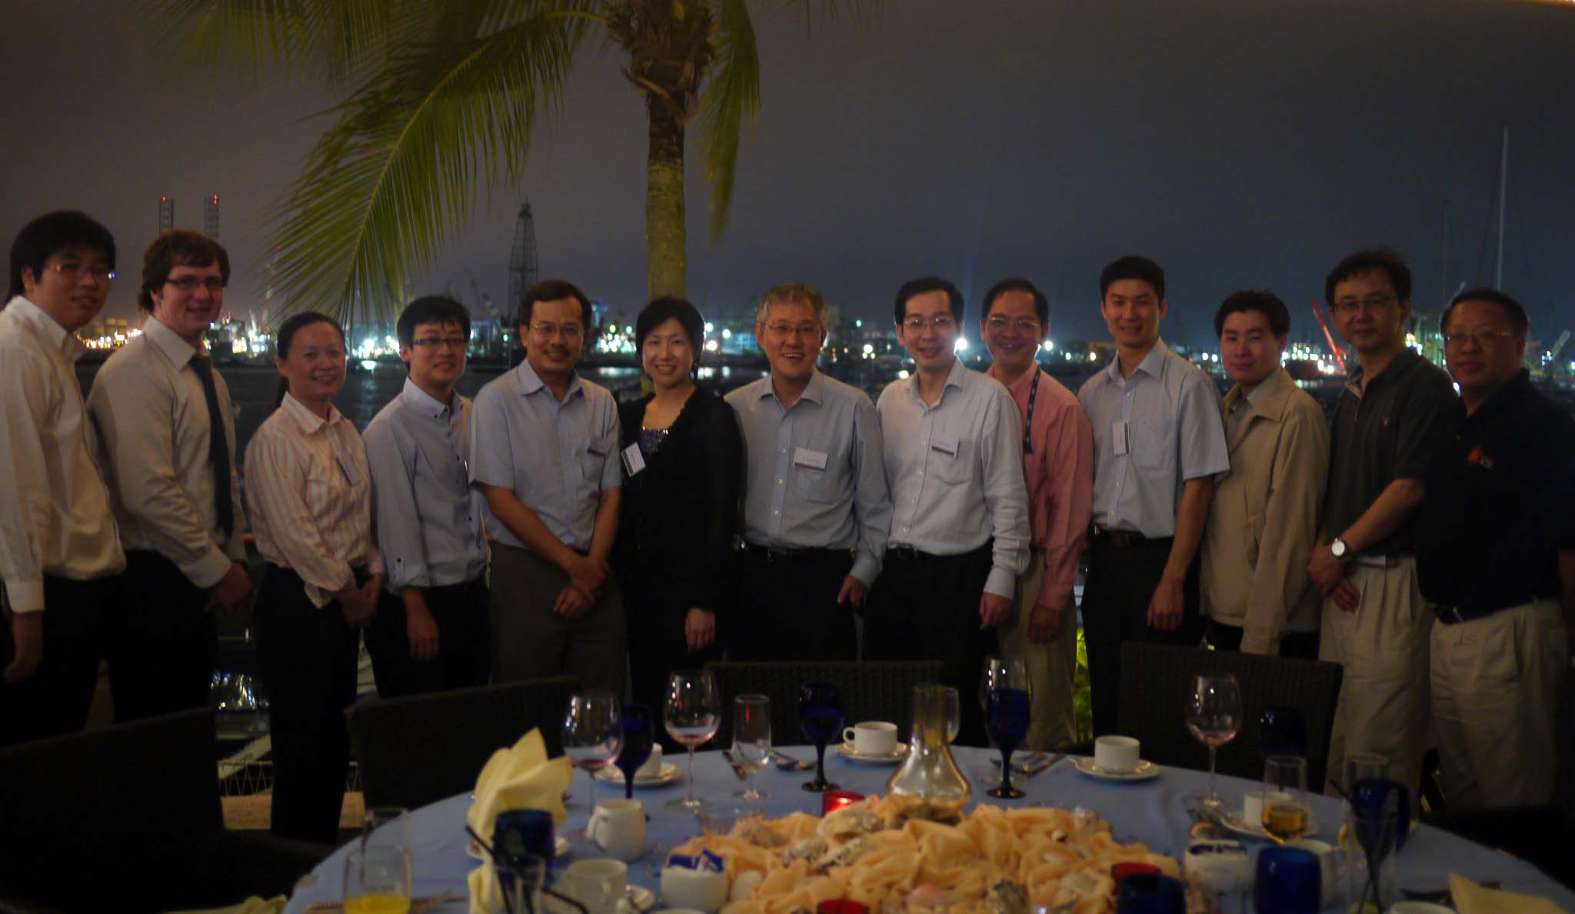
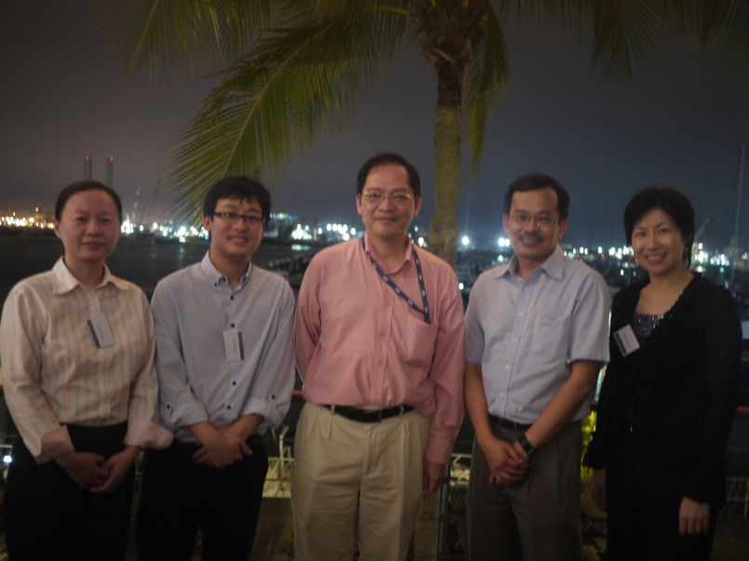
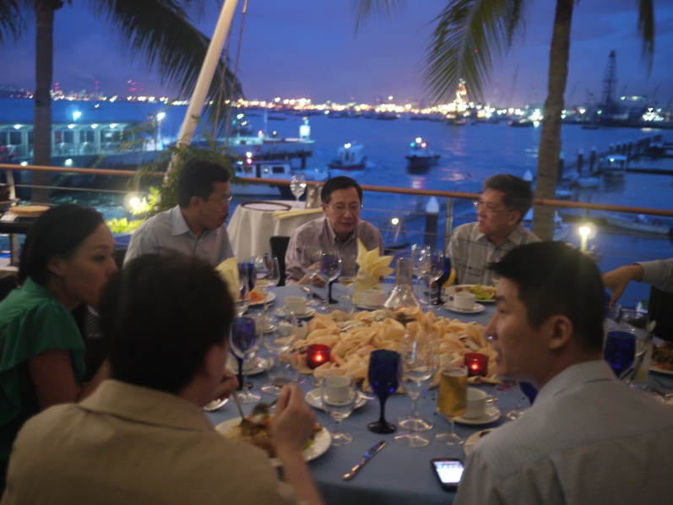
SingAREN Events
SingAREN Members’ Night, 15 July 2011

Slide 30
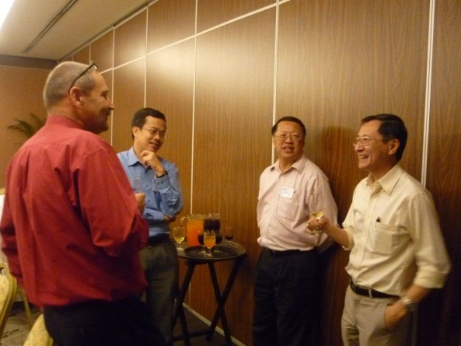
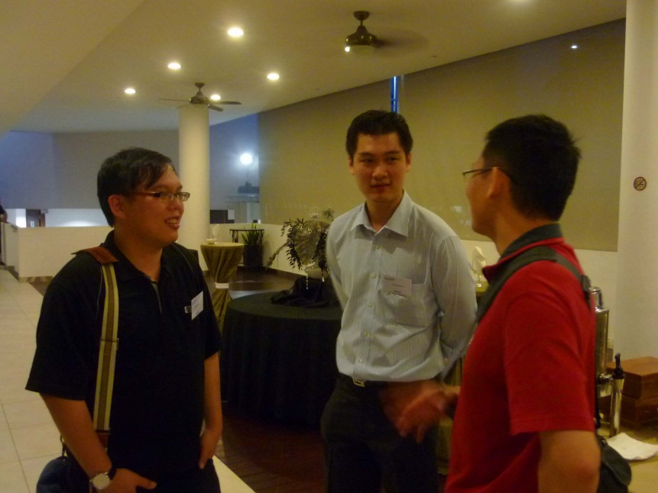
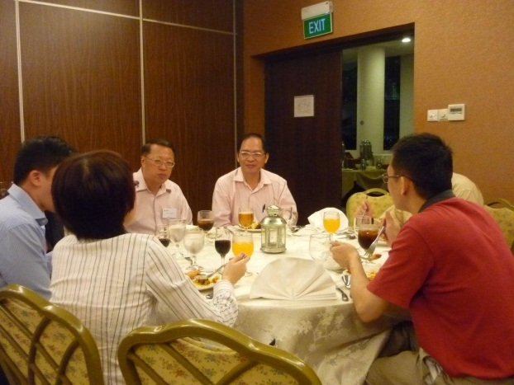
SingAREN Events
SingAREN – Festive Cheers, 12 December 2011

Slide 31
Thank You
www.singaren.net.sg
ipv6.singaren.net.sg

